Slide 1
Innovative Starters Award
15 May 2024
F. Billen – Innoviris
WELCOME! The presentation will start shortly!

Slide 2

Welcome!
Do you have the ambition to undertake a large-scale strategic project in the field of R&D and innovation, with the aim of creating value both for your company and for the region?
Will you dare to take up the challenge of a competition in which young companies with high technological potential from all sectors and with very varied backgrounds are competing, while at the same time wanting to promote Brussels as a region at the forefront of innovation and an example of economic transition?

Slide 3
If so, the « Innovative Starters Award » is made for you…
Contest - 14th edition – most innovative start-ups of the region.
Startup competition, selection on the basis of a Strategic Innovation Plan (SIP):
  Max 36 months
  Global nature: R&D (must have !), business development, finance, marketing, …
Solutions in line with the 6 strategic innovation domains defined in the Regional Innovation Plan:
- Advanced digital technologies and services (including technologies and services related to the domains mentioned below);
- Climate: sustainable buildings and infrastructure;
- Optimal use of resources;
- Efficient and sustainable urban space and flows;
- Health and personalised and integrated care;
- Social innovation, government innovation and social inclusion.

Slide 4
If so, the « Innovative Starters Award » is made for you…
Max € 500.000 par company, up to 3 winners
All expenditures necessary to undertake the SIP are eligible

Slide 5
Our goals
Help you grow your business, through a real strategic breakthrough
Generate value for the Region
Economic value
Social and/or environmental value
Impact on the regional ecosystem
Making the Brussels Region an innovation hub with cutting-edge technological capabilities

Slide 6















A few past winners
And many others…

Slide 7
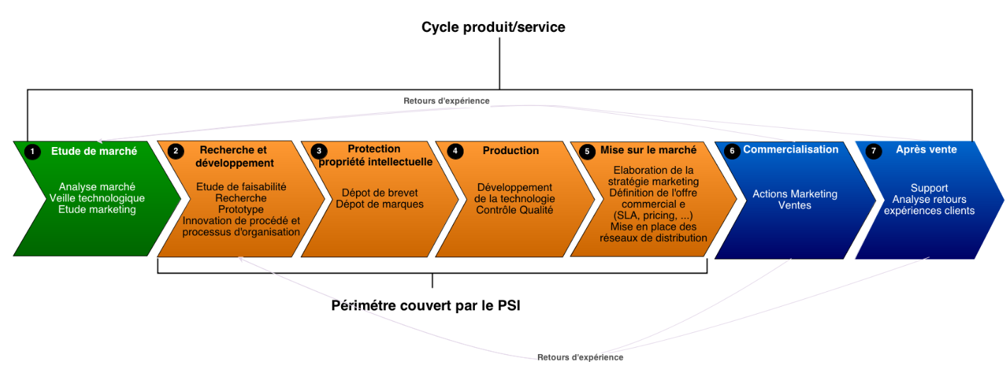
Innovative Starters Awards
The Strategic Innovation Plan (SIP) is meant to be global in scope (i.e. broader than just R&D)
We want to support your global strategy for the next 2-3 years
We expect SIPs to remain primarily technological in nature, but to include other types of strategic tasks helping you to scale up and/or to reach maturity.

Slide 8
Planning
15/05 – Inspiration & Infos Session
5/07 – End of the call
Jury
Administrative phase
Avril 24
Mai
Juin
Juillet
Aout
Septembre
Octobre
Novembre
Décembre
Preselection
Government
formal decision
Call Opening

Slide 9
Timeline
Projects can start between 1/12/2024 and 31/12/2024
Max duration : 36 months
Minimum duration: none, but rarely < 12 months (because the plan needs to be strategic…)

Slide 10
Step 1 – Eligibility (July)
Be an unlisted small enterprise, registered < 5 years, which has not taken over the activity of another enterprise, has not yet distributed profits, has not been formed through a merger.
Your company needs to have been created by the submission deadline (5 July) and on or after 1/1/2020
Prove that you are an innovative enterprise
  EITHER By submitting an evaluation by an external expert that you will develop new or substantially improved (compared to the state of the art in your industry) products, processes or services
  OR By proving that your R&D costs amount to at least 10% of your total operating costs in at least one of the last three years
Have offices in Brussels, where the SIP will be undertaken
Have fulfilled your obligations to the Region if you have previously received a grant
Not be a RISE or ISA laureate
Not be in financial difficulty according to EU law (by the submission deadline)
Have submitted a complete application (electronic copy only) by 5 July.

Slide 11
Step 2 – Preselection (July)
Done in-house at Innoviris, using the same criteria as for the final evaluation
On the basis of your written application
Goal: identifying the best applications that should move on to the next stage (5-6)
Technological aspects
Financial health & business strategy
Financial health
Transversal aspects
Strategic character of the SIP
Social
Environnement
Local ecosysteme
Impact on the Brussels Region
Innovative nature of the SIP
Coherence and realism of the workplan and budget
Technological challenges
Competence of the team
Coherence of the global strategy and business plan in the context of economic transition
Quality and relevance of the financial plan
(Formal) quality of the application

Slide 12
Step 3 – Jury (September)
Jury composed of representatives from Innoviris and other regional institutions (Finance.brussels) + external experts (business angels, technical experts, startup coaches, academic experts)
Short presentation followed by a Q&A session
Same criteria as for the preselection

Slide 13
How to fill in the application form ? Do’s and Don’ts
The application form should contain all necessary information (and it only) -> follow the instructions !
Main sections:
  Summary of the application
  Info about the company
  Financial data
  SIP
  Market study and valorization

Slide 14
SIP, most important sections
Explain the context of the SIP (what challenges are you facing? What will you do? Why will it allow you to tackle these challenges?)
Show us that you have a coherent, global plan for taking your company to the next level
Follow the WP template. We want to know what you will do, which technological challenges you will meet, and what you will get
Please don’t just list technologies or use buzzwords (e.g. “we will leverage machine learning to do X”) – be specific (which precise technique? Where will you get the data from? Why is it challenging?)
Budget : follow the template. If in doubt, don’t hesitate to contact us !

Slide 15
Market study and valorization
Explain what you did to determine that you SIP was commercially viable and to evaluate its potential
Why will the SIP be good for the company (turnover/business, jobs, know-how etc.) ?
Why will it be good for the Region (sustainability, local ecosystem, citizens/workers wellbeing, etc.)?
Explain how you intend to manage the growth of the company (e.g. if you are planning to hire 30+ people by 2025, will you move ? Do you have to HR processes to manage this ?)
Provide a business plan and a financial plan. Explain clearly how they were constructed (i.e. don’t just provide numbers – give us your assumptions and hypotheses). Explain how the expected growth can be at service of the economic transition.

Slide 16
After you win…
We will sign a grant agreement in December 2024
You will submit a short report every six months. We will also see you to have a short demo of the results
You will have automatic access to other regional tools (pitch in front of the economic coordination council, become part of the “ISA alumni”, etc.)
You will be asked to promote the image of the Region as a pioneer in innovation and economic transition
Three years after the end of the project, you will submit a report to give us information about how the results were used
! you can not receive another subsidy to undertake the same tasks.

Slide 17
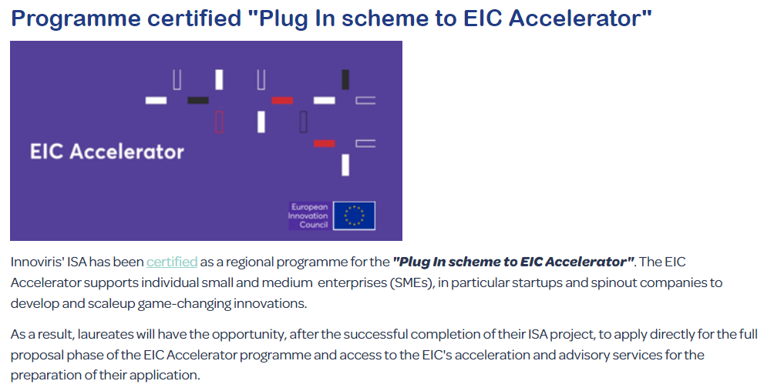

Slide 18
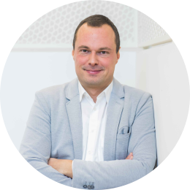
BILLEN François
fbillen@innoviris.brussels
+32 2 600 50 28

